Slide 1
Leprosy for Medical students

Slide 2
Cardinal signs of leprosy
Skin lesions
Loss of sensation
Thickened superficial nerves
Demonstration of M leprosy in tissue biopsy or smears
Two of the first three or the last is diagnostic

Slide 3
Classification based on the Immunological spectrum of leprosy (For research only)
Indeterminate
LL
BL
BB
BT
TT

Slide 4
Classification for treating leprosy with MDT by paramedics
Cases will be diagnosed on the number of skin lesions
PB will be 5 lesions or less; MB will be > 5 lesions
Note that the classification has been simplified and is based on skin lesions and loss of sensation

Slide 5
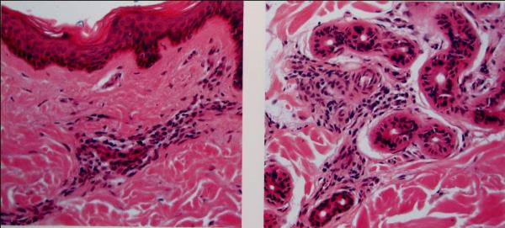
Indeterminate leprosy
Mono-nuclear cell infiltrate around blood vessels, nerves and sweat glands

Slide 6
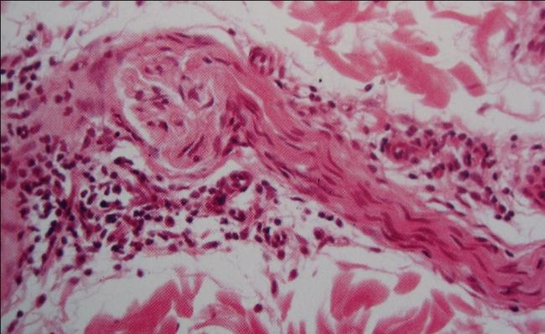
Indeterminate leprosy
Mild perineural mono-nuclear cell infiltrate around a nerve

Slide 7
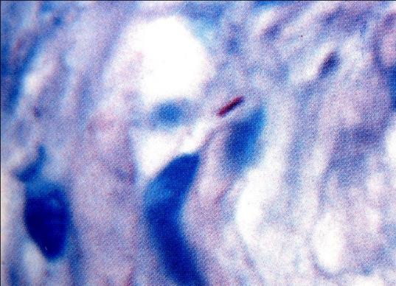
Indeterminate leprosy
A single acid fast bacillus in a nerve (Fite stain)

Slide 8
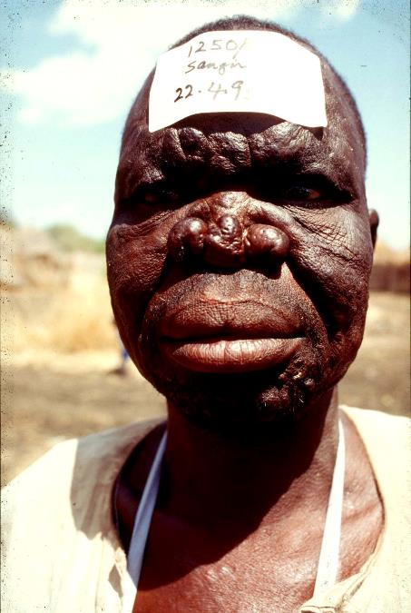
Lepromatous leprosy (LL)
Infiltration of the skin with farrows in the forehead and depressed nose
He had laryngeal involvement. His voice remarkably improved after tripple therapy
His wife had BT leprosy and his son had indeterminate leprosy

Slide 9
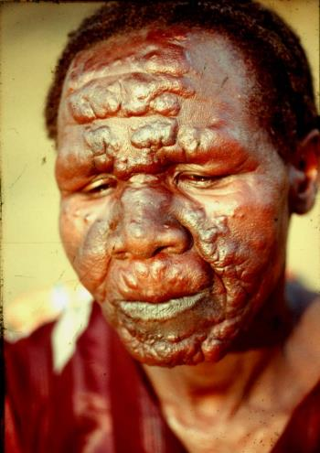
Lepromatous (LL) leprosy
Note symmetrical nodules and plaques with loss of hair of the eyebrows

Slide 10
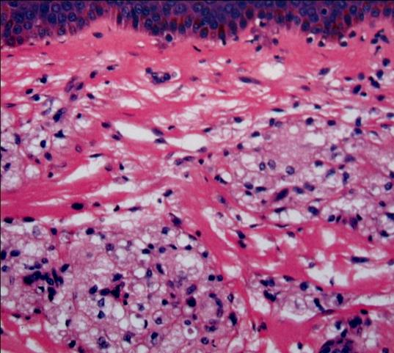
LL Leprosy
Cells with foamy cytoplasm in LL leprosy. Note clear zone between epidermis and dermis. Lymphocytes are scanty

Slide 11
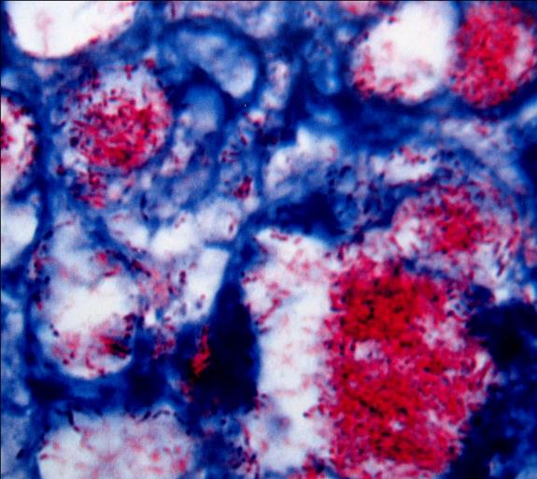
Lepromatous leprosy (LL)
Numerous acid fast bacilli some in large globi (Fite stain)

Slide 12
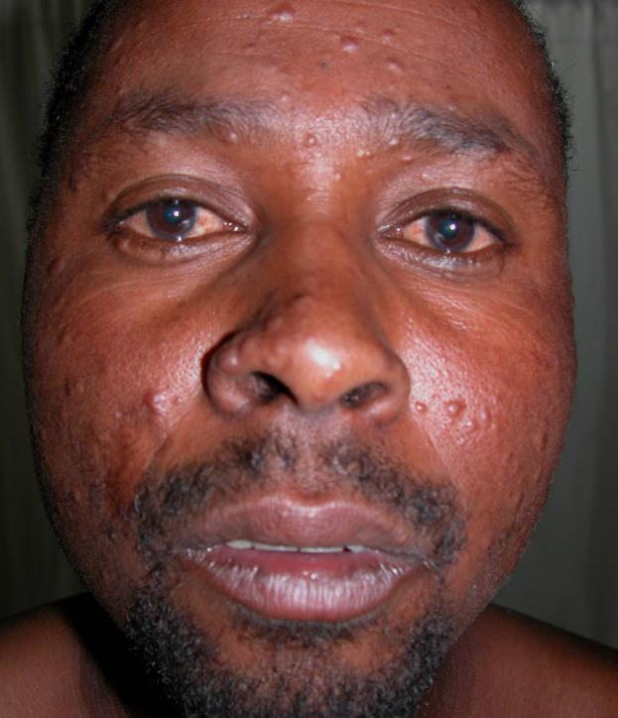
BL leprosy
Asymmetric papules and nodules
Facial hair normal
Note the colour of the eyes is starting to become red. This an indication of pending involvement of the eye.

Slide 13
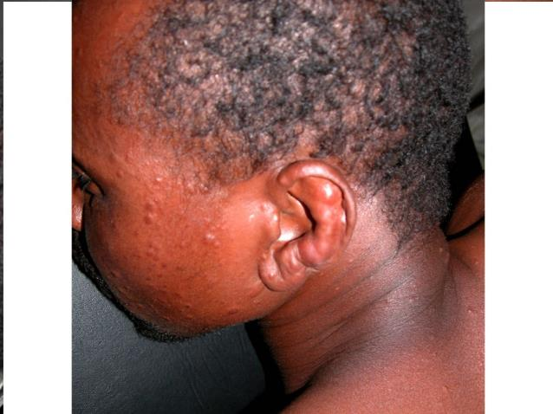
BL leprosy
Lobulation of the ear lobe
This is a site for making slit smears

Slide 14
BL Leprosy Asymmetric papules and nodules on the back

Slide 15
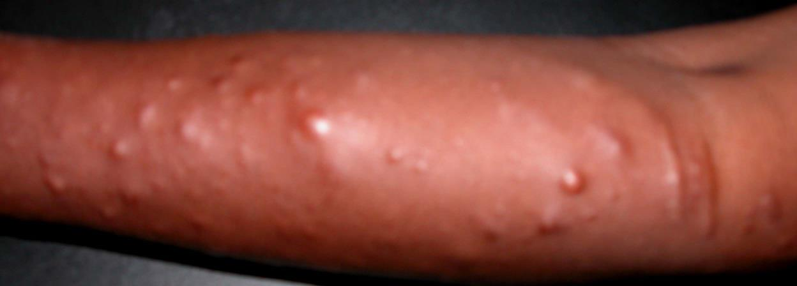
BL: nodules in the forearm

Slide 16
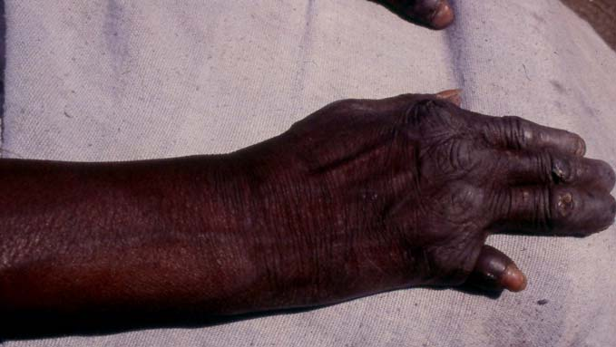
Lepromatous leprosy resoption of the little finger

Slide 17
DD Ainhum
Ainhum is the autoamputation of a digit, usually of the fifth toe bilaterally and as a result of a constricting scar in the form of a band or groove
The fingers are rarely affected

Slide 18
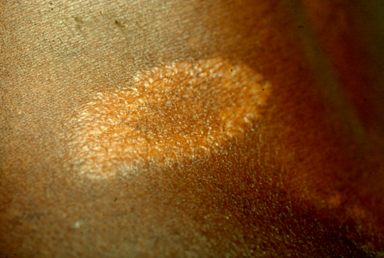
Tuberculoid leprosy (TT)
A single anaesthetic dry lesion with a clearly demarkated margin and healing in the centre

Slide 19
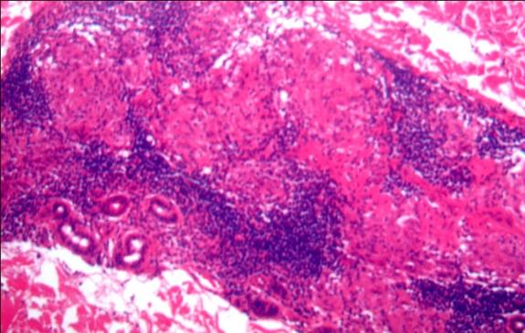
Tuberculois leprosy (TT)
Discreet epithelioid granulomas surrounded by small lymphocytes destroying sweat glands

Slide 20
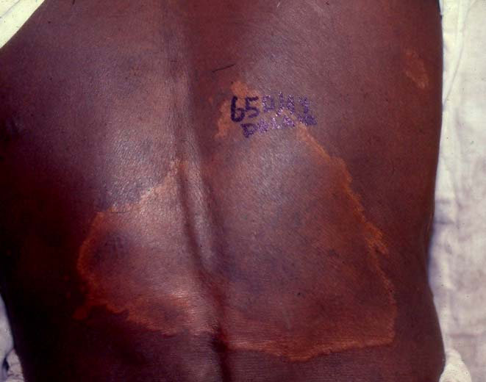
BT leprosy
Large macular lesion in the back. Note healing in the centre and satellite lesions (arrows)

Slide 21
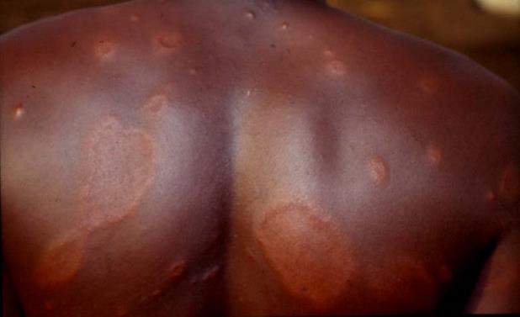
BT leprosy
Macular lesions with raised margens

Slide 22
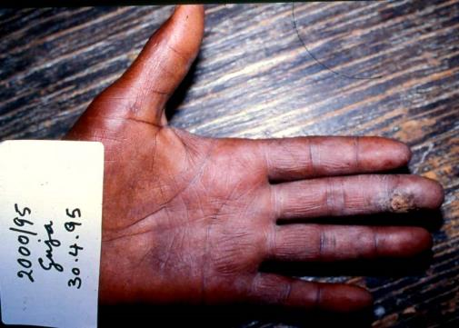
BT leprosy
A manual labourer with ulcers in the fingers. He had loss of sensation particularly over the distribution of the ulner nerve. Note atrophy of the thenar and hypothenar muscles

Slide 23
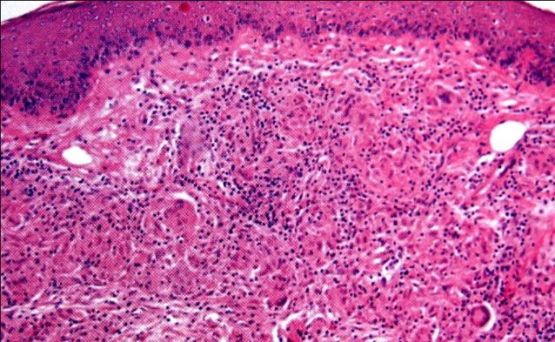
Borderline leprosy (BT)
A granuloma composed of epithelioid and an occasional giant cell. Note clear zone between the granuloma and epidermis. Lymphoid cells are penetrating the granuloma

Slide 24
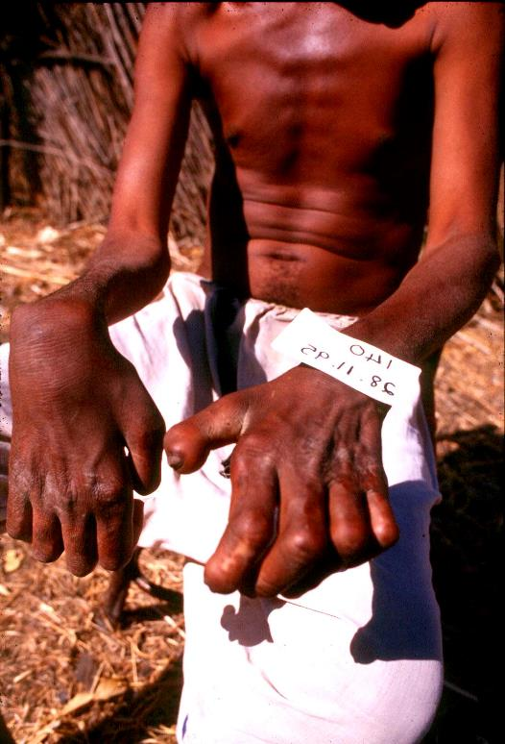
BT leprosy
Patient has right wrist drop and claw hands

Slide 25
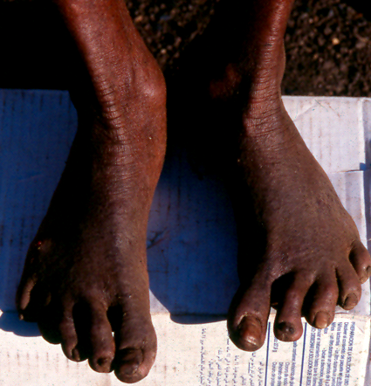
BT leprosy
Feet turned inwards with claw toes

Slide 26
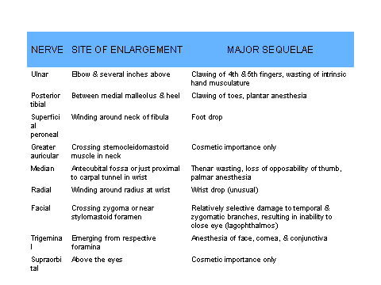

Slide 27
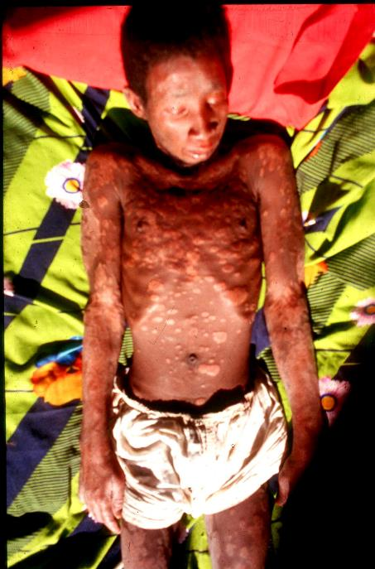
Type 1 reaction in a BT patient
Down grading reaction. Patient had more lesions than before
All lesions appeared inflamed
Patient looked ill, lost weight and facial hair

Slide 28
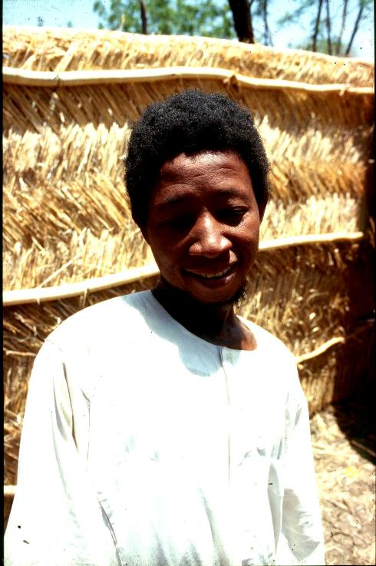
Type 1 reaction after steroid and multidrug therapy

Slide 29
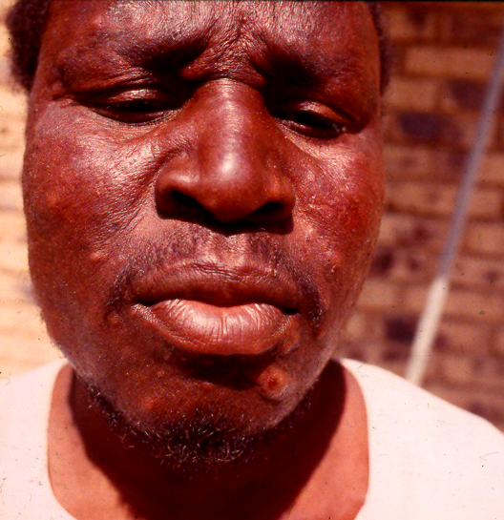
Erythema nodosum leprosum (ENL
Nodules in the face

Slide 30
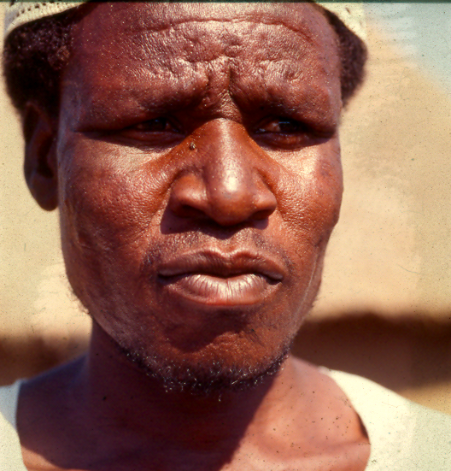
Erythema nodosum leprosum (ENL)
Same patient after steroid therapy.
The patient relapsed and we gave him thalidomide and he responded
He died in a car accident

Slide 31
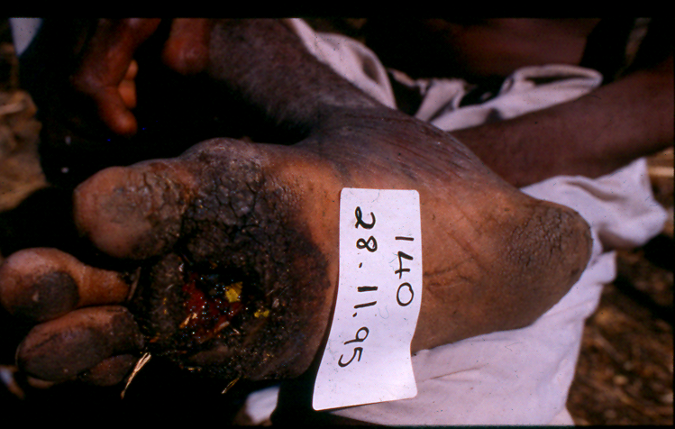
BT leprosy showing a perforating ulcer of the foot

Slide 32
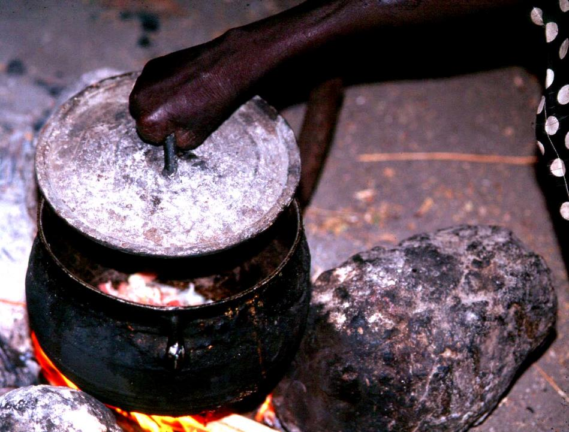
A patient with deformity and anaesthetic hand holding a hot lid. This is how patients sustain burns

Slide 34
Prevention of disabilties
Patients should avoid touching hot objects with their hands
Use a piece of cloth (part of the Toub or Emma) to hold hot objects

Slide 37
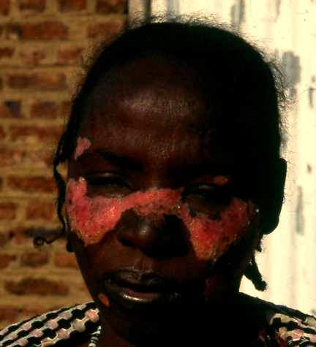
Differential diagnosis
Descoid lupus erythematosis with a red depigmented butterfly appearance in the face

Slide 38
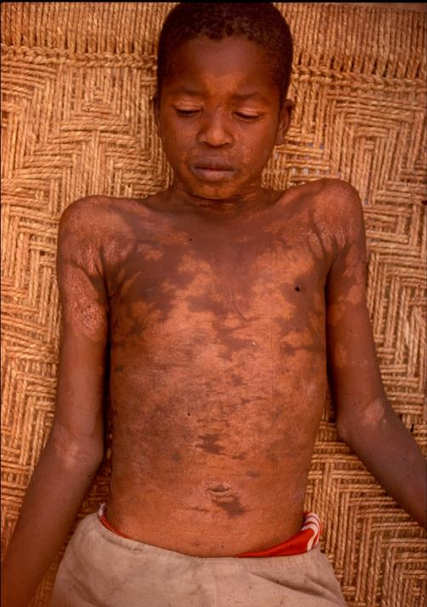
Differential diagnosis
Patient showing extensive depigmentation from PKDL
Note lesions are symmetrical

Slide 39
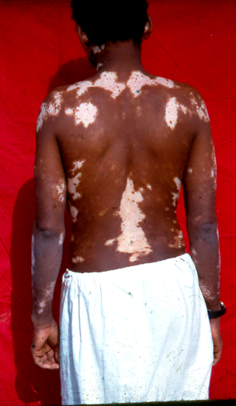
Differential diagnosis
Vetiligo showing depigmentation of the back and arms

Slide 40
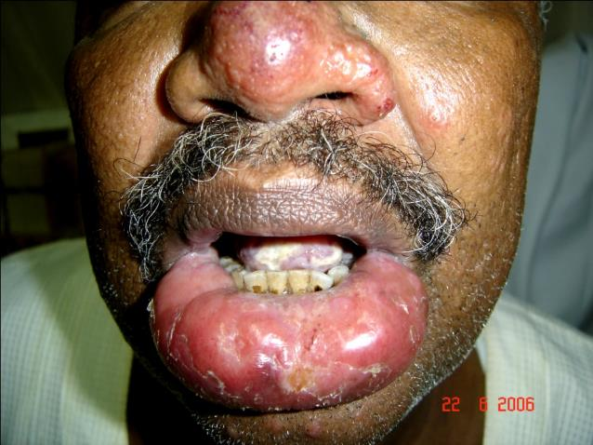
Differential diagnosis
Patient with cutaneous leishmaniasis of the lip and nose

Slide 41
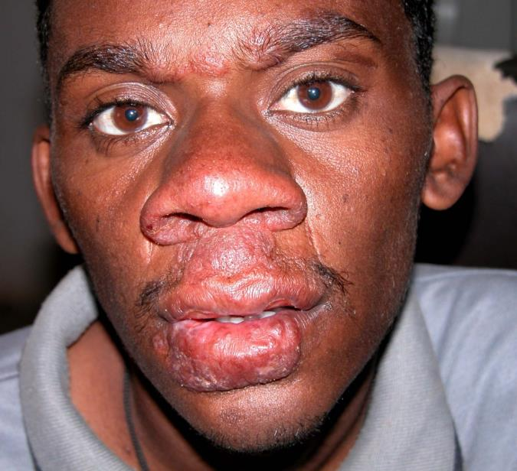
Differential diagnosis
Patient with mucosal leishmaniasis of the lip and nasal mucosa

Slide 42
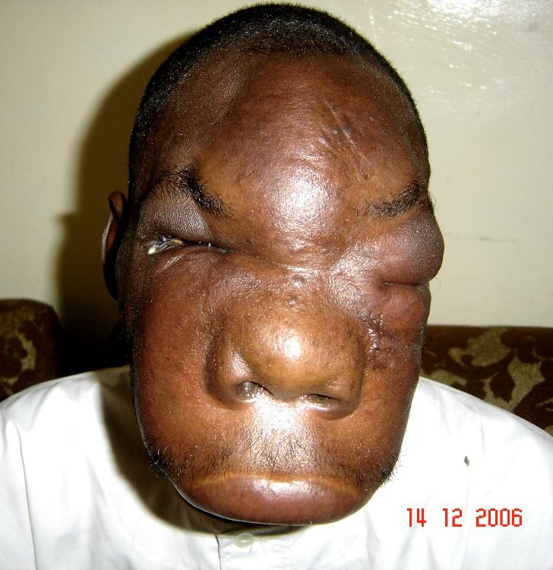
Differential diagnosis
Patient with zygomycosis

Slide 43
Treatment
Patients used traditional medicine with herbs, mihaya and coterie

Slide 44
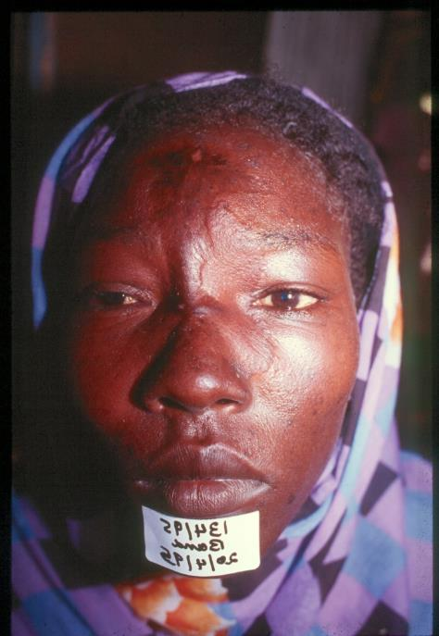
Leprosy patient treated by burning the lesions on the face
Note the scar but the lesion is still active at the margins of the scar

Slide 45
Lepromatous (LL) leprosy
Note symmetrical nodules and plaques with loss of hair of the eyebrows

Slide 46
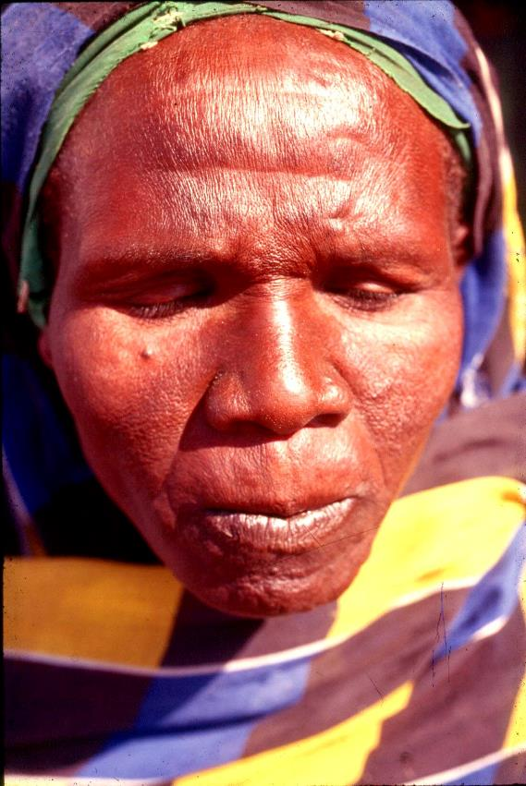
Lepromatous leprosy (LL) after treatment
Same patient as in previous slide one year after treatment with three drugs

Slide 47
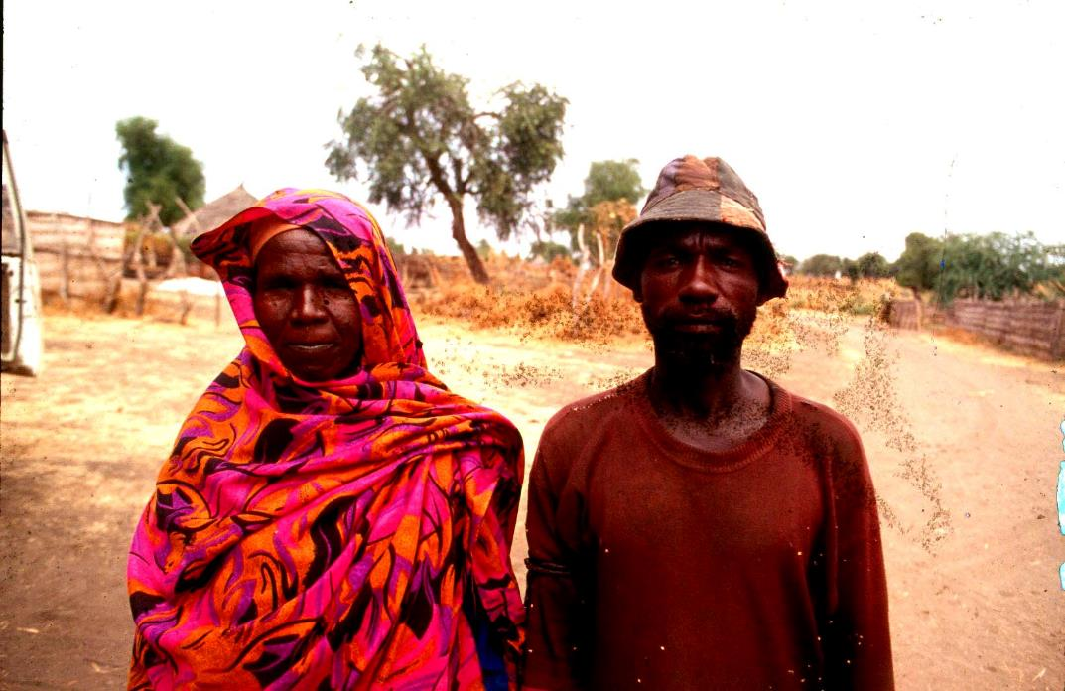
Patient shown in previous two slides cured of LL leprosy. She remarried. Seen here with her new husband

Slide 48
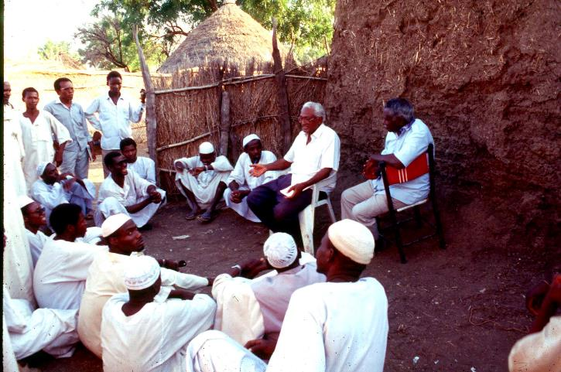
Conducting KAP study on leprosy in a village

Slide 49
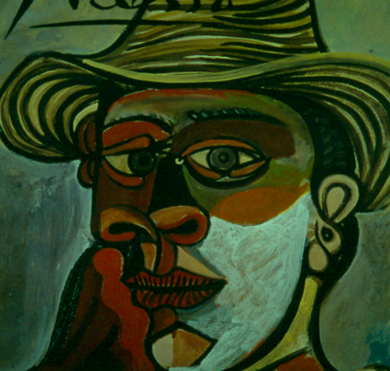
A deformed face, lobulated ear and hand by Picasso: was he inspired by leprosy patients to portray human suffering?

