Slide 1
Leishmaniasis: Where are we now and where to go
A M EL Hassan

Slide 2
The main clinical forms of leishmaniasis
Visceral leishmaniasis (Kala-azar) and its main complication post kala-azar dermal leishmaniasis (PKDL)
Cutaneous leishmaniasis (zoonotic and anthroponotic).
Leishmania diffusa in Ethiopia and South America
Mucosal leishmaniasis

Slide 3
There are common gaps in our knowledge concerning the magnitude and distribution of the various forms of leishmaniasis.
There are also specific areas which are poorly understood in each of the different forms

Slide 4
Epidemiology
The most common area that cuts across all forms of leishmaniasis in which we need more information is epidemiology.
The satellite maps prepared by Dia some years ago were the first maps that showed the determinants of the distribution of VL in Sudan. Perhaps they need to be updated and extended to other forms, particularly CL
Is it possible to predict areas where outbreaks may occur?

Slide 5
The epidemiology should include clinical surveys, vectors and reservoir of infection
This needs multidisciplinary teams that we are trying to organize now

Slide 6
The vector of VL in Sudan
This map was prepared by Lewis in 1956
It shows the distribution of various sand flies in Sudan
Does this need updating?

Slide 7
Vectors
The problem being addressed by Dia concerning the vector or possibly vectors of VL is a step in the right direction

Slide 8
Reservoirs of infection
As yet we have no concrete evidence about the major reservoir hosts for the various forms of leishmaniasis. Dogs, mongoose, rats have all been incriminated since the work of NAMRO in Upper Nile in 1960s
We suspect that PKDL may be a reservoir of infection. Where is the proof?
For cutaneous leishmaniasis we have a single paper in which the Nile Rat is implicated. It is based on a limited number of animals

Slide 9
Now to specific diseases: VL
Why is it that some individual develop VL and others develop subclinical infection?
Does the use of impregnated NETS protect against VL? Dia has shown in preliminary studies that those using NETS tend to develop subclinical infection
Do insect repellents protect against VL?

Slide 10
He IEND in collaboration with the FMH had prepared Guidelines for the diagnosis and management of VL
Musa is updating this in collaboration with FMH

Slide 11
Vaccines
Our first vaccine of Autoclaved L major and BCG was not immunogenic enough but the Alum adjuvant form was much more immunogenic when tested in healthy volunteers
We need to try it in the field but then we are unable to obtain it from our collaborators in Iran. Can we manufacture it locally?

Slide 12
Using this vaccine for immunochemotherapy against PKDL has succeeded in lowering the time for cure from 120 days to 40 days

Slide 13
New drugs for VL
This is being taken care of by LEAP Musa can expand on this

Slide 14
PKDL
Immune responses in PKDL are being addressed now by the IEND
This is a continuation of the work of Musa. We hope to really dissect the immune response in PKDL patients and try to answer the question why some patients develop PKDL and others do not

Slide 15
We have data showing that genetic factors play a role as described by Hiba. This work is expanding and further proof of the genetic basis for susceptibility to PKDL is underway
And of those who develop PKDL some heal their lesions spontaneously while others become chronic, persisting for months or even years

Slide 16
We just concluded a study about the use of a recombinant three antigen Leishmania PolyproteinLeish-F2 with adjuvant Mpl-Se along with Pentostam for the treatment of PKDL
The code is supposed to be opened in May this year

Slide 17
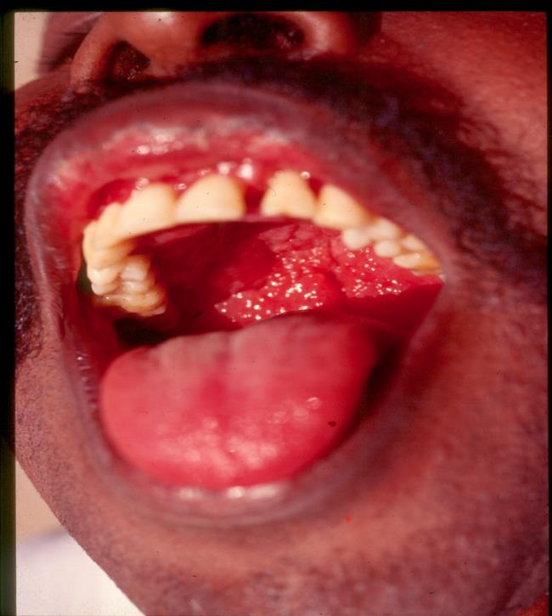
Mucosal leishmaniasis: Clinical features
Nodulo-ulcerative form. The mucosa of the palate is swollen red and fissured.

Slide 18
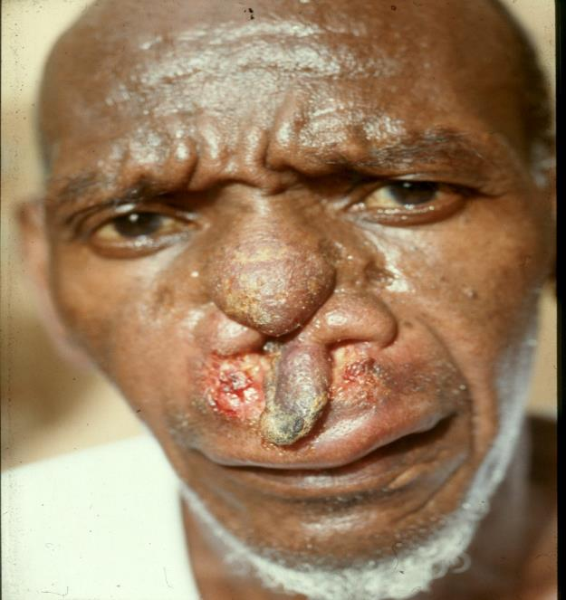
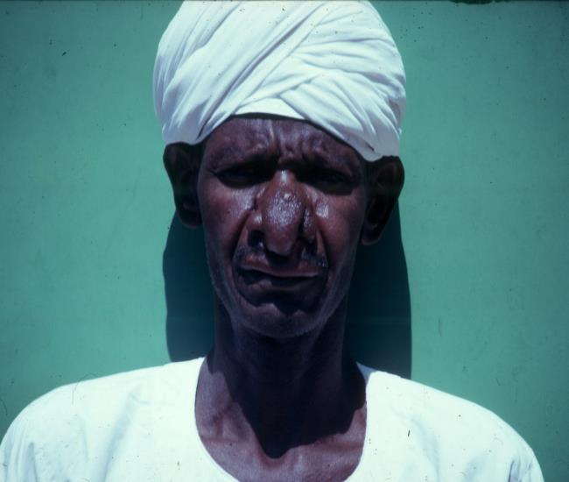
Mucosal leishmaniasis is destructive if not properly treated
Patient 20 years later Patient in 1968

Slide 19
Mucosal leishmaniasis
Least common of the leishmaniases
May be primary or follow VL. Why?
Parasite typed as L donovani in all cases so far. Supported by epidemiological evidence
Distribution is like VL but some cases are from Dongola and Port Sudan. What is the vector there? Is the parasite L donovani in these areas?

Slide 20
Mucosal leishmaniasis
Clinical manifestations, diagnosis and treatment are well described
Immune responses poorly documented

Slide 21
Misdiagnosis
Many cases of mucosal leishmaniasis and PKDL are mistaken for other conditions and are given the wrong treatment with dire consequences
I give some examples

Slide 22
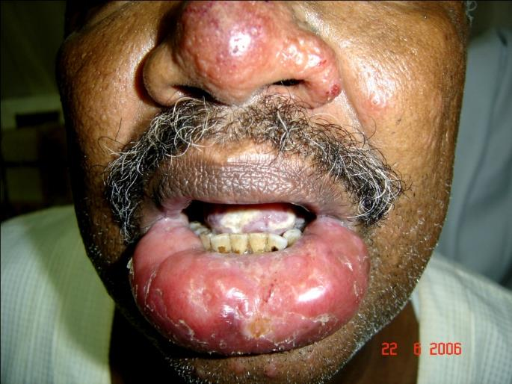
Effect of steroid therapy: patient was treated elsewhere with systemic steroids
His lower lip was grossly swollen
The tongue showed a white membrane that proved to be candida infection

Slide 23
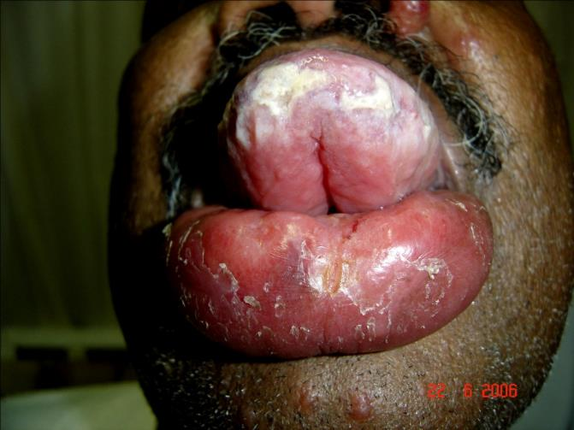
Candida of the under surface of the tongue
Patient from Fashaga. Parasite was L doovani by PCR. We stopped steroid and treated him with AmBisome

Slide 24
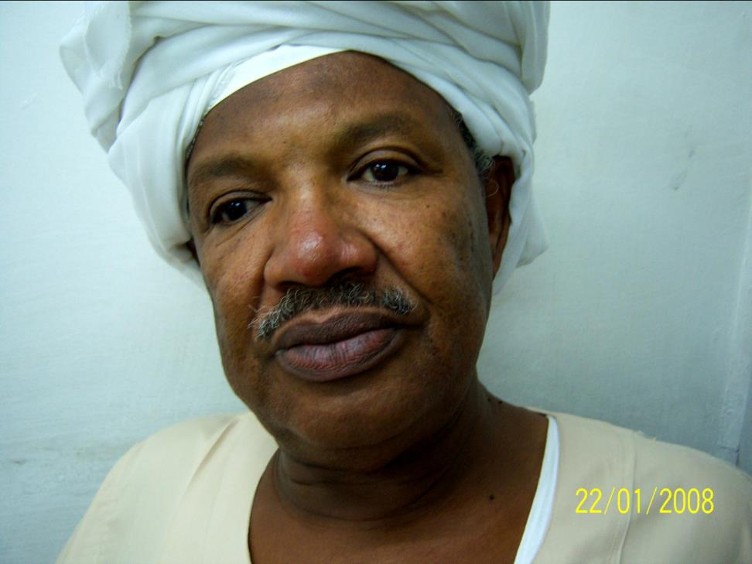
After treatnent

Slide 25
Referred by a consultant as PKDL
13 years old girl from Babanousa. Depigmented lesion. Asymmetric. Loss of sensation. Thick nerves

Slide 26
We conclude from this that training at the undergraduate and postgraduate levels is poor
We are organizing a course in tropical diseases that we hope to start in November this year
This is in collaboration with the University of Gazeira

Slide 27
Long term research plan for the next 10 years is badly needed
This should include universities, Federal and State Ministries of Health and communities in endemic areas
We need local funds and commitment from the state in addition to International agencies and interested research groups

